Slide 1
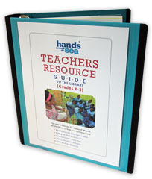
Adapting the Lesson Plans
Notes:
The Teachers Resource Guide to the Library offers a total of 20 lesson plans (five for each grade) in Grades K through 3 that use common books from the library that Hands Across the Sea has sent over the years and that ELP has recommended for use to teach reading skills with. But I often get two common questions.

Slide 2
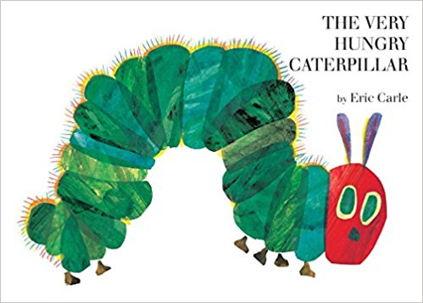
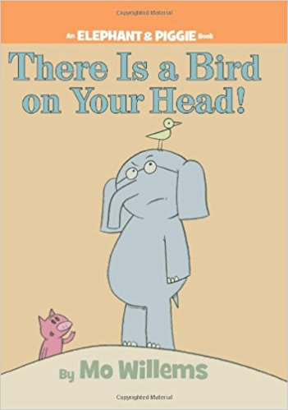



What if I don’t have these exact books in my library?
Notes:
*What if I don’t have these exact books in my library?

Slide 3
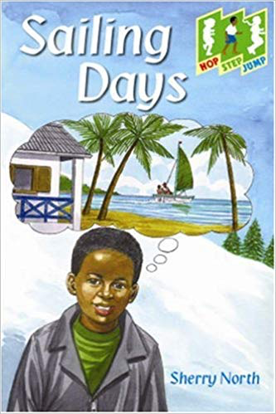
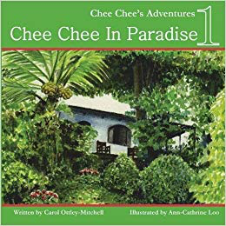
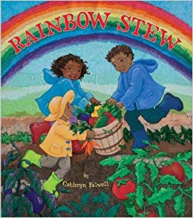
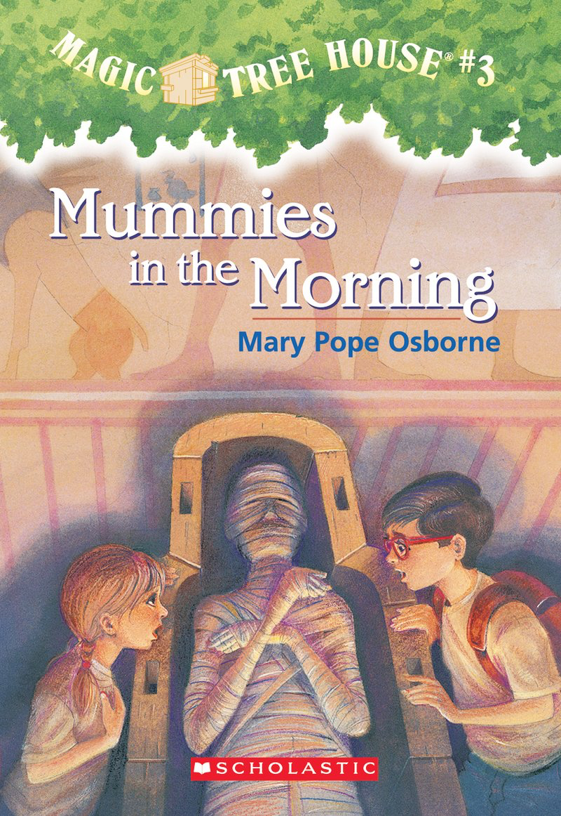

What if I teach Grade 4-6?
Notes:
*And what if I teach Grade 4 through 6?

Slide 4
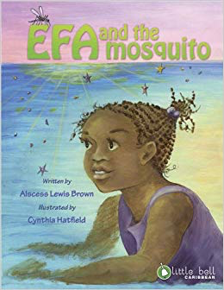
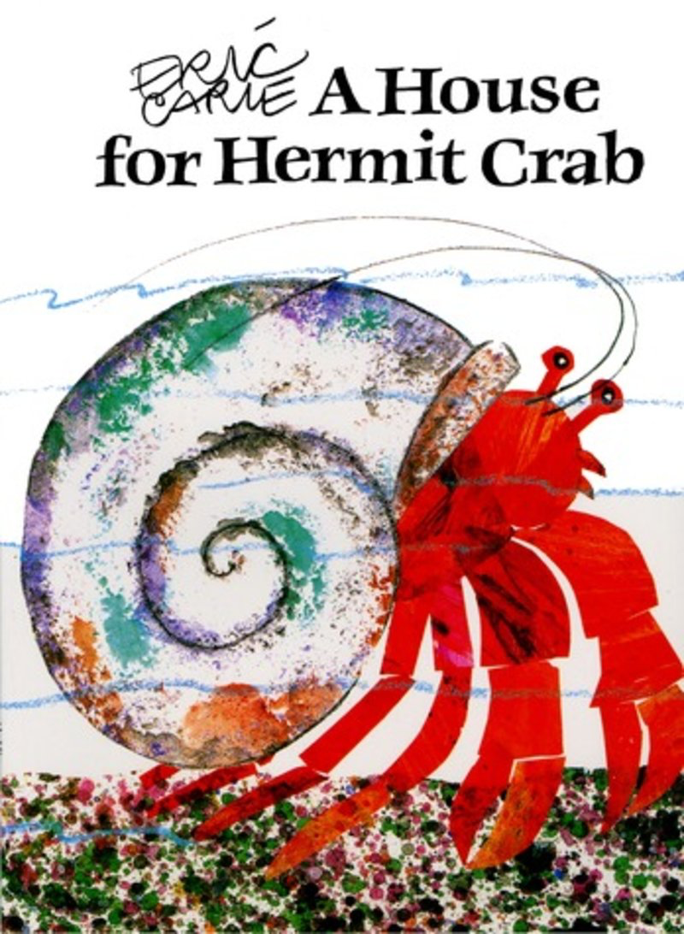
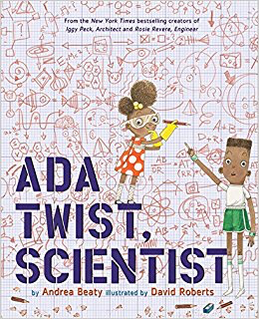


GOOD NEWS!
Notes:
*Well I have some good news for you! These lesson plans can be adapted for different books in your library. That means if you don’t have A House for Hermit Crab in your school library, you can still use the activities suggested in this lesson plan in the Teachers Resource Guide for another book that you DO have. And in this video, I will show you and model for you how to make that happen!
I will also show you how to adapt a Grade 2 or Grade 3 lesson plan activity for older students in Grades 4, 5, and 6. And I will share with you how to do that too!

Slide 5
What does it look like?
Adapt the TRG activities to ANY book that you have in the library.
Notes:
What does it look like to adapt the TRG activities to any book that you have in the library? *Let’s choose one of the activities from the Ada Twist Scientist lesson plan to model how.

Slide 6
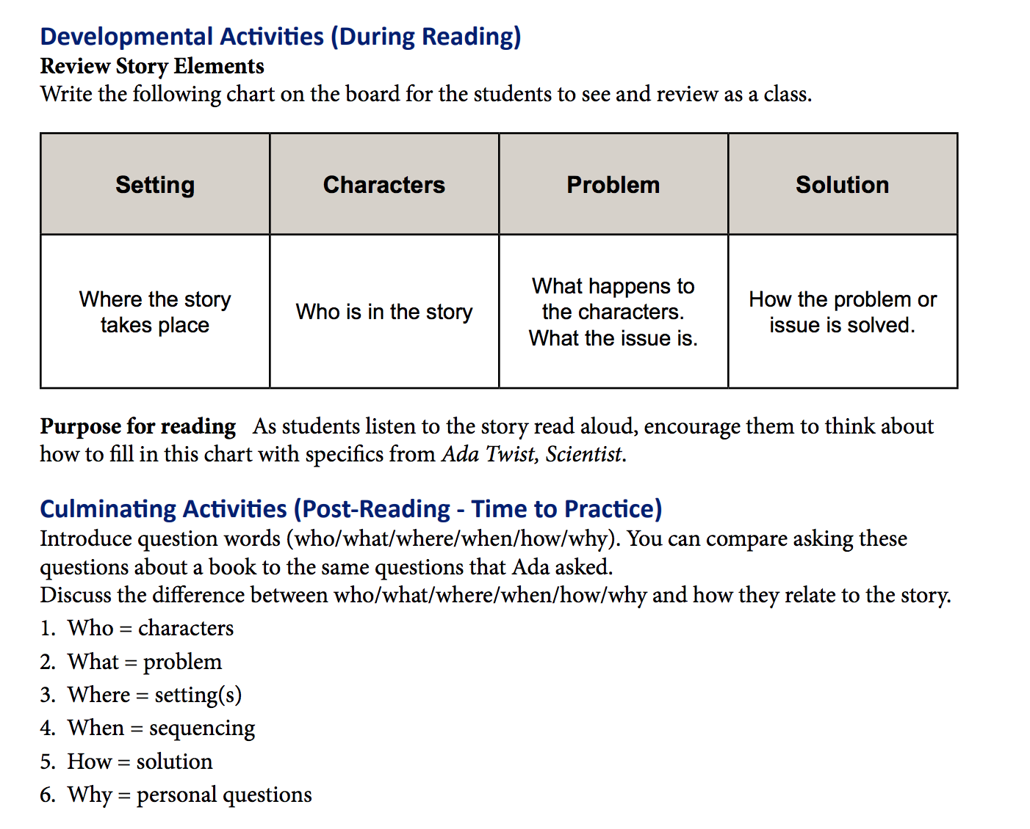
What if I don’t have Ada Twist, Scientist?
But I really liked the activity (Review Story Elements) suggested in the lesson plan section of the TRG for it.
Notes:
*So you don’t have Ada Twist Scientist. But you really liked the activity called Review Story Elements suggested in the lesson plan that goes with this book. Instead of Ada Twist Scientist, you’ve got the book *Six Crows by Leo Lionni. How about adapt this activity to the book that you DO have in your library.

Slide 7
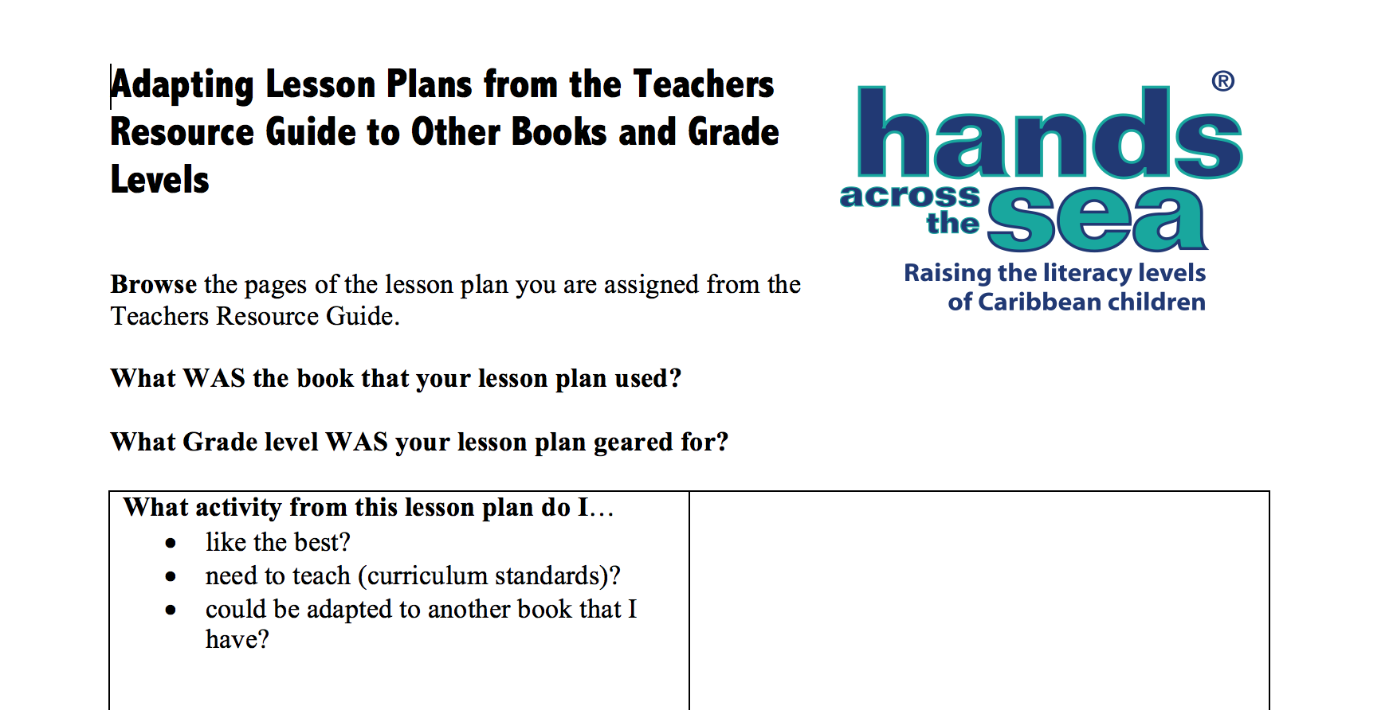
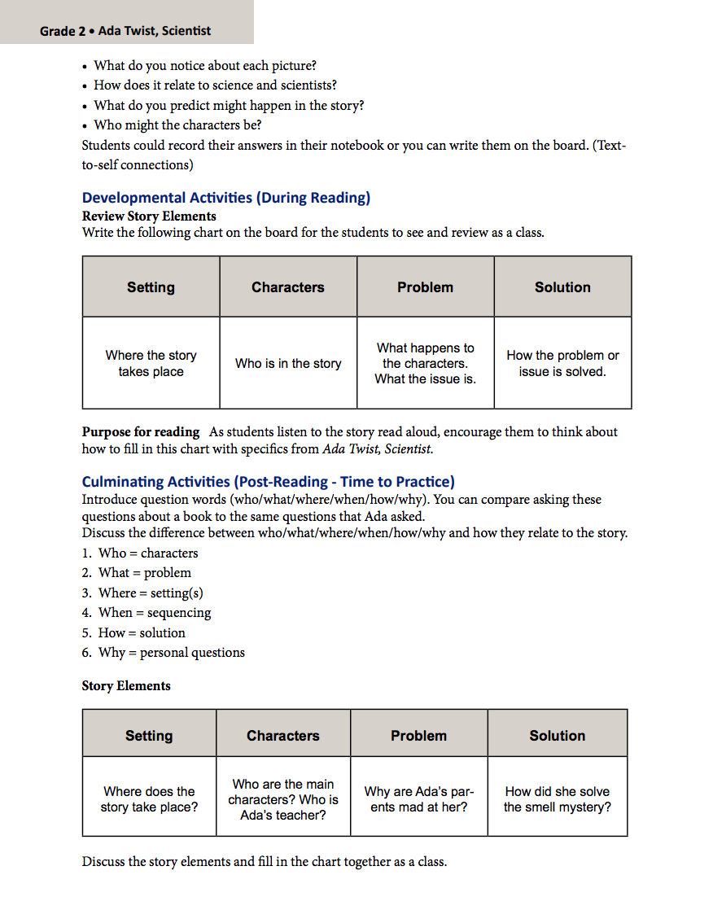
Ada Twist Scientist
Grade 2
Story Elements – graphic organizer
Notes:
*The following graphic organizer has helped me in coaching teachers how to adapt lesson plans from the Teachers Resource Guide to other books and grade levels. Let me walk you through the steps and model how to complete it, so you can be able to do the same thing too. First browse the pages of the Teachers Resource Guide like we’ve been doing throughout this workshop. Remember I chose the Story Elements activity. What WAS the book that you lesson plan used? *Ada Twist Scientist. What grade level WAS your lesson pan geared to? *Grade 2. What activity from this lesson plan do I…like best? Need to teach (curriculum standards are the same or similar to what I have to teach)? Could be adapted to another book that I have? *Story Elements – graphic organizer. *You can find the name of the book and grade level *in the top corner of the page. The activity I have chosen is a *Developmental activity and then *Culminating activity (which takes place after the reading) which can be done during the reading of the book. This is not necessarily something you need to record on the graphic organizer, but it is good to be aware of when the activity was suggested, so you can use it in the same way with the book you are adapting it too.

Slide 8

Read through the activity considering how you can best adapt it to the different book.
Notes:
*Read through the activity considering how you can best adapt it to the different book.
*Perhaps put a sticky note or two on the pages of the book that you may want to reference with your students when introducing this activity or completing it.
*This activity asks the teacher to write the following on the board for the students to see and review as a class.
*Setting: where the story takes place.
*Characters: who is in the story.
*Problem: what happens to characters. What the issue is.
*Solution: How the problem or issue is solved.
*Purpose for reading: As students listen to the story read aloud, encourage them to think about how to fill in the chart with specifics from Six Crows.
Depending on the abilities of your children, you may want to prompt the students with questions throughout the book and walk them through a think aloud to highlight the characters, setting, problem, and solution.
The Culminating Activities happen after the read aloud. *This Reviewing Story Elements continues as a post-reading activity.
Introduce question words (who/what/where/when/how/why). You can compare asking these questions about a book to the same questions that Ada asked…
Now this part, we simply adjust to Six Crows by using our question words to discuss the differences and how they relate to the story.

Slide 9
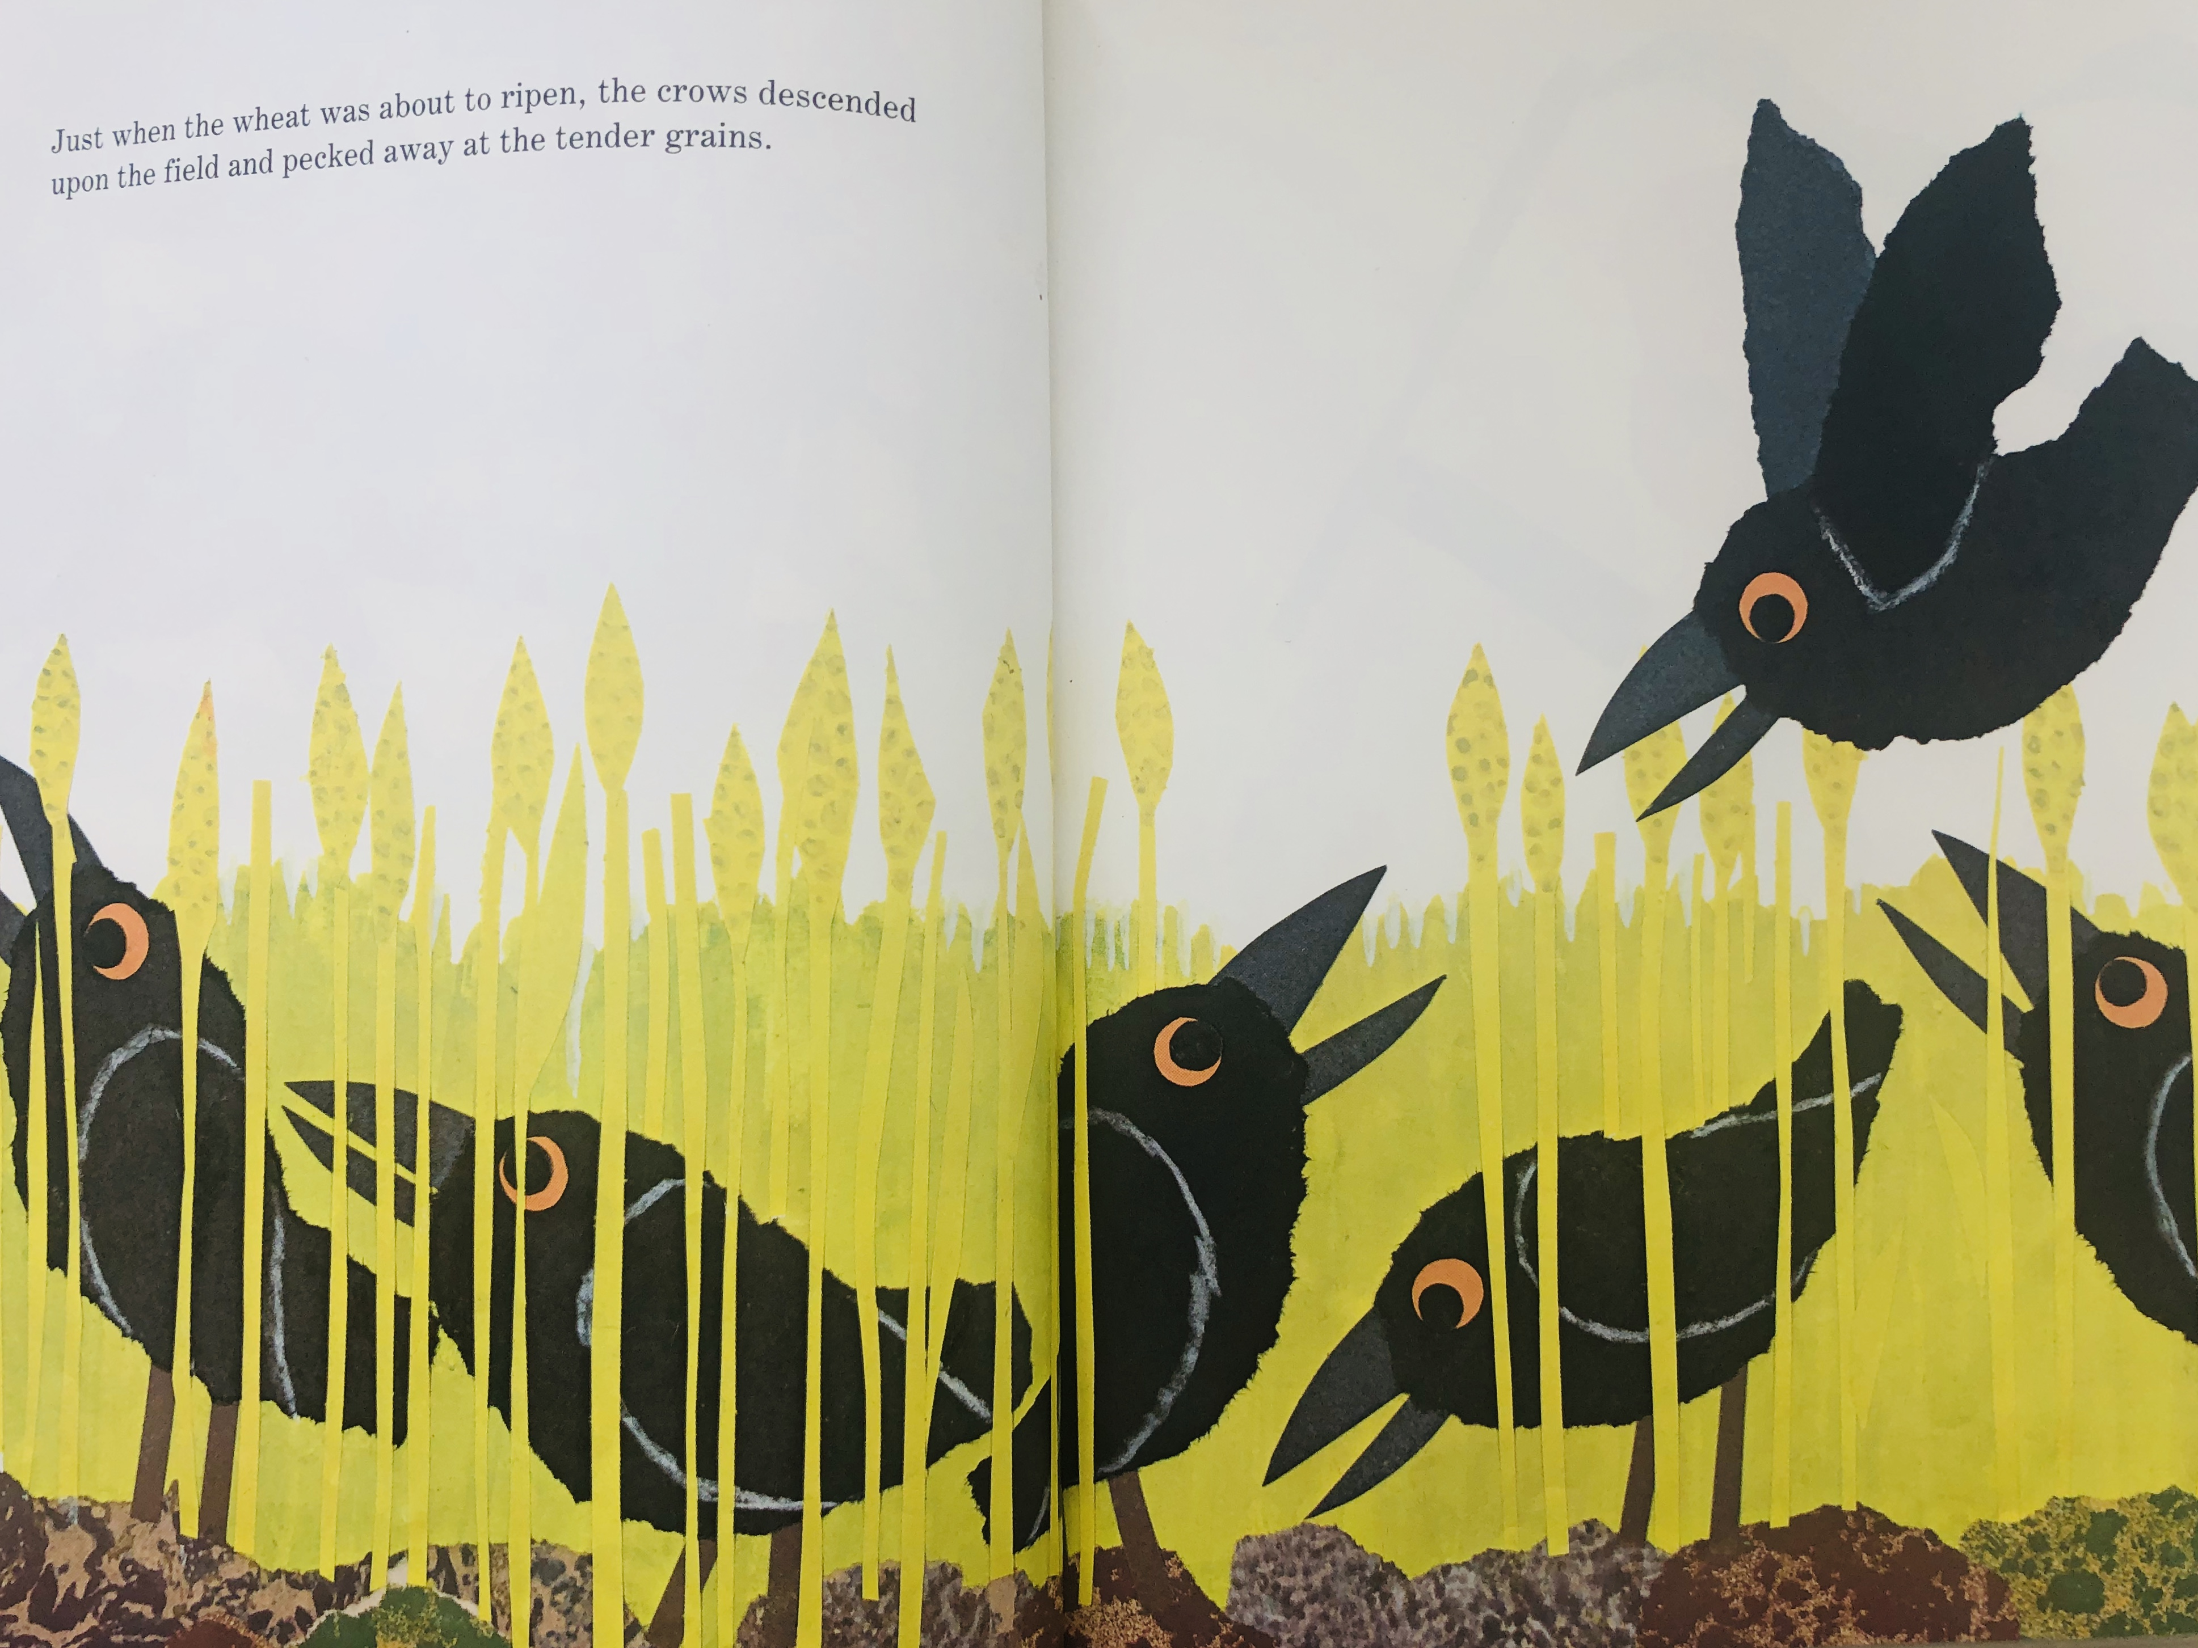
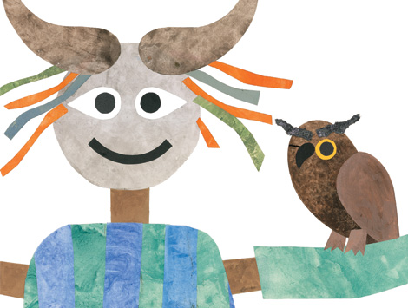
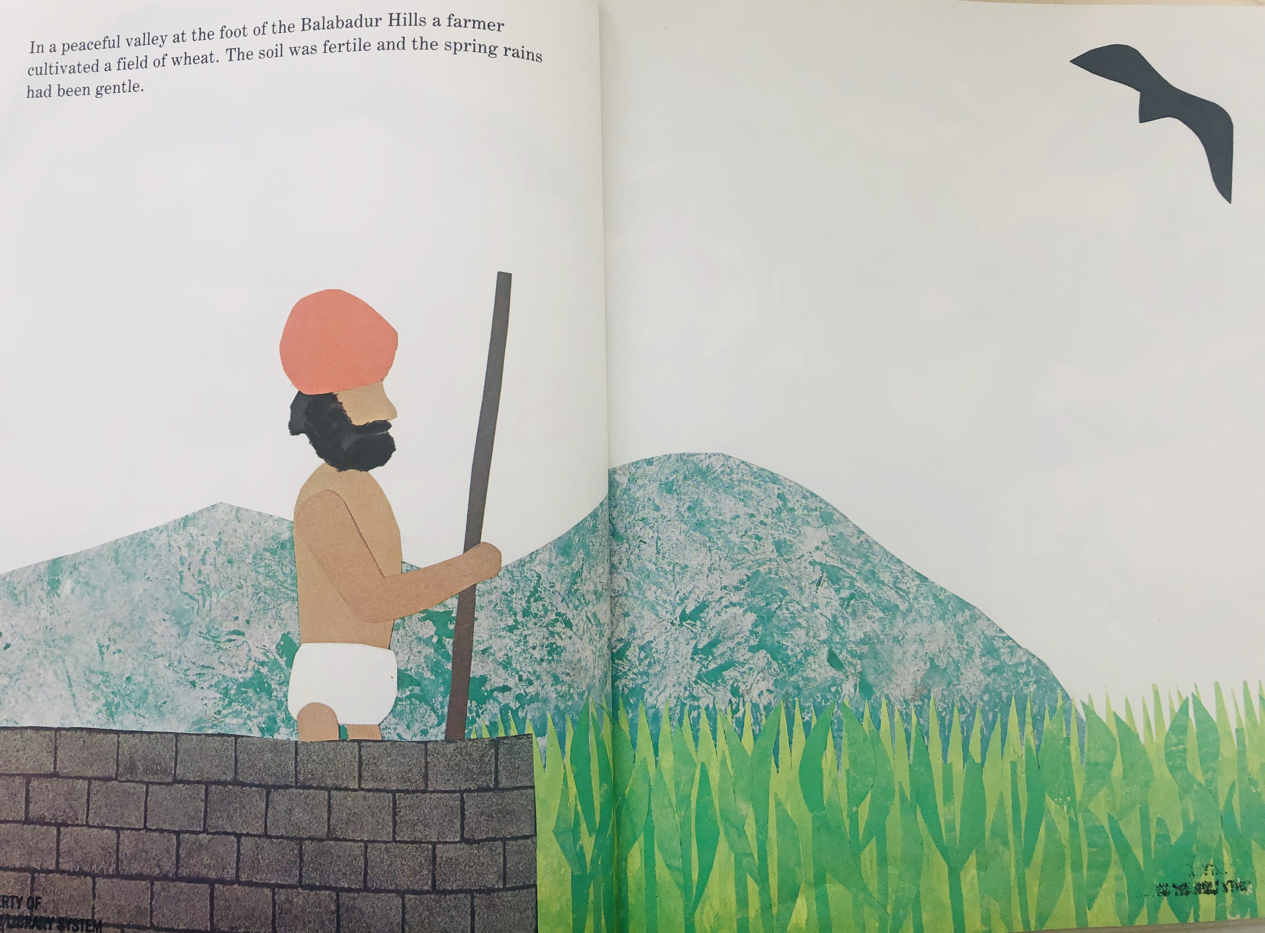
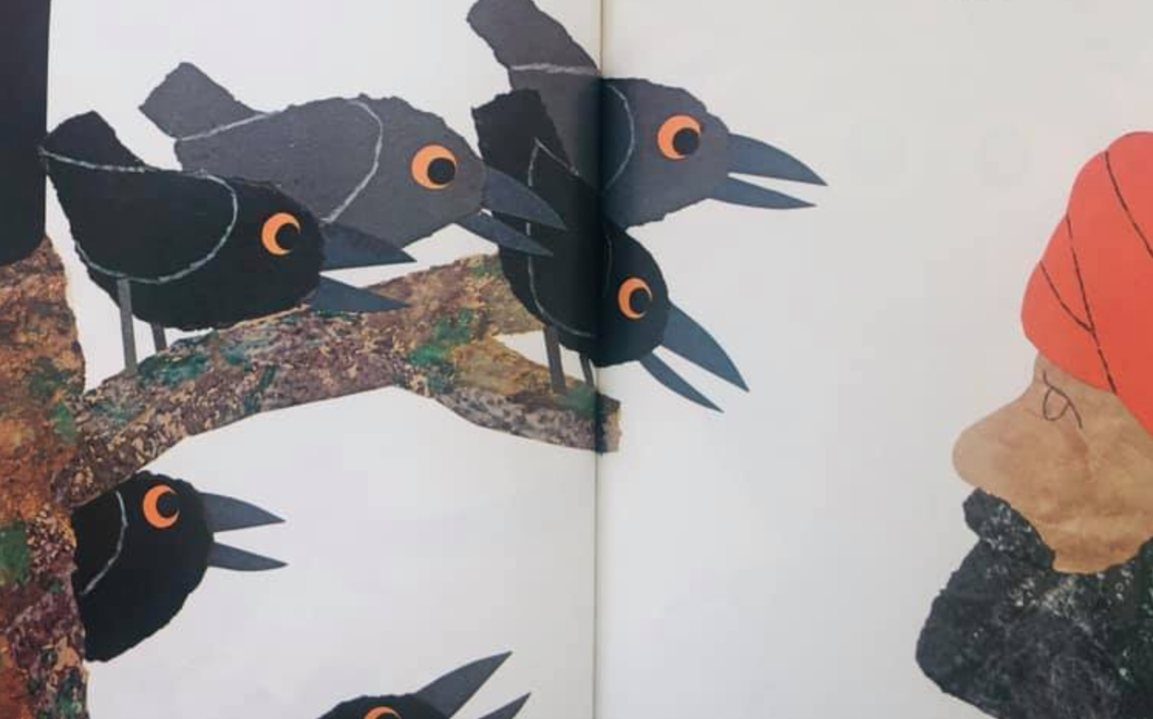
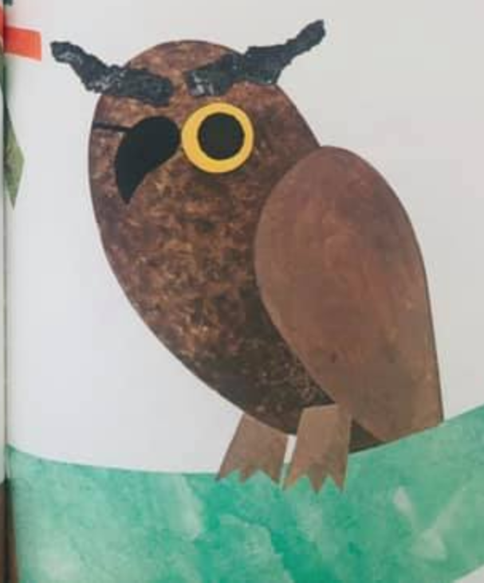
Notes:
**Who is the question word that identifies the characters in a story.
What is the question word that identifies the problem.
Where is the question word for setting.
When is a question word for sequencing
How is a question word to explain the solution.
And why is a question word that digs deeper with personal questions.
*Discuss the story elements and fill in the chart together as a class.
*For setting: where does the story take place? We know from the beginning of the book that the story takes place in a peaceful valley at the foot of the Balabadur Hills on a farmer’s wheat field.
*For characters: who are the main characters? For the “Who is Ada’s teacher” question. We could ask something like, who lives in the tree trunk or which character did not live in a tree? *We know there are a total of six crows in the story, a farmer, and the *wise old owl. This may be a good time to discuss with the students whether or not the scarecrow or the kite should be considered as characters—ask the students why or why not? Having students talk about what they think and explaining why they think so are important skills we can practice through having conversations like this.
*For the problem: Why are Ada’s parents mad at her? How could we change this question to produce the problem from the book Six Crows? Why are the crows and the farmer not getting along? What happened between the crows and the farmer that is causing a problem? *This is when the students can talk about how the crows were eating the wheat, and the farmer wanted them to stop. But you as the teacher can lead them toward the greater problem—which is that neither the crows nor the farmer were talking to one another about the situation. They were just jumping to conclusions and trying to infuriate one another—the crows with the kite and the farmer with his scarier scarecrow. The real issue was miscommunication. Again, great opportunity to talk to the students about how this happens in real life all the time. Connecting the problem in this story to their own lives is an excellent skill that can be practiced through the use of this read aloud too.
*Finally, the solution: How did she solve the smell mystery? We can change that question to be something like—how did the crows and the farmer resolve the problem? Or what did the owl suggest the crows and the farmer do to deal with the situation?

Slide 10
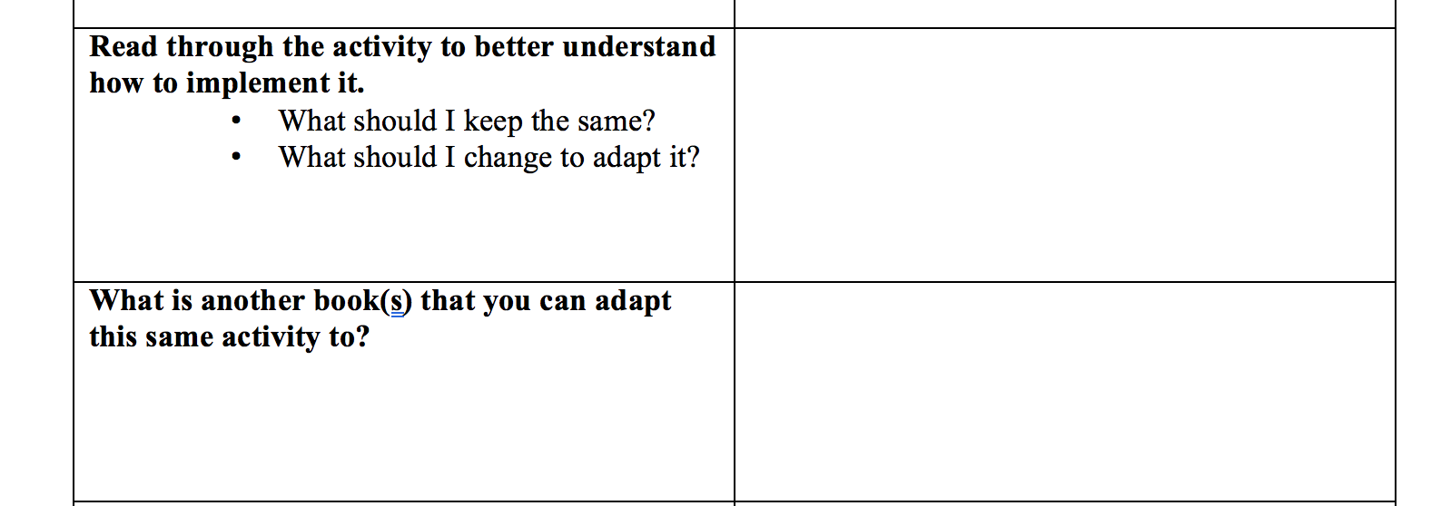
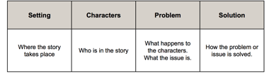

Crows
Farmer
Owl
Wheat field
Talking it out
miscommunication
What happened between the crows and the farmer that is causing a problem?
How did the crows and the farmer resolve the problem?
Notes:
*Going back to the graphic organizer, the whole point of this is to lead you through making these changes to the lesson plan in adapting it to the other book.
*So read through the activity to better understand how to implement it—just like we did. Consider the questions: What should I keep and what should I change to adapt it as you are reading through it.
*You can see where I copied the Story Elements table in this space, but I started writing different answers to think through how to reword the questions to fit the Six Crows story and that way I could prompt my students in generating the correct answers.
*Then I want you to take this to the next level. What is another book that you can adapt this same activity to? Now that you have adapted this activity to the book Six Crows, you may start thinking about other books that could lend themselves to the same or similar activity—stories with very prominent settings, characters, problems, and solutions. One book that comes to mind is called Corduroy. Corduroy is about a bear in a department store who has never been bought because his overalls are missing a button and no one wants him. Main character, setting, problem—bam! Read the rest to find out the solution, and you’ve got another book that supports this same activity. You can actually coach your students to do the same activity on their own with the book of their choice and make a similar chart in their reading notebooks to discuss in book clubs.

Slide 11
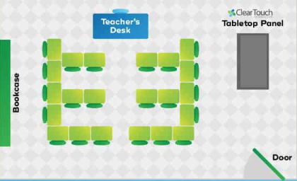

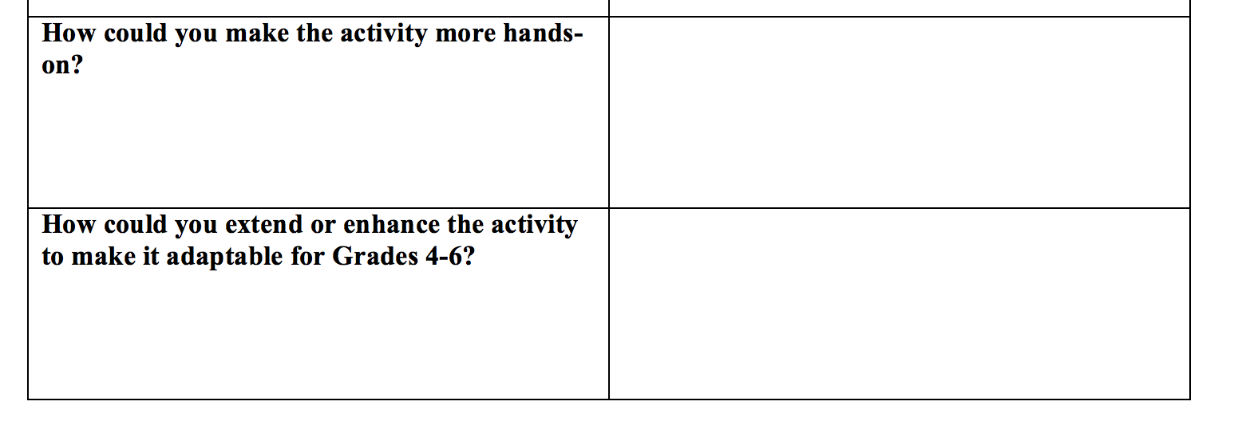
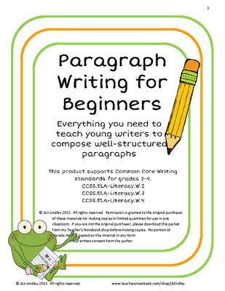
setting
solution
Turn the classroom into the graphic organizer and have 4 stations around the room for (1) setting (2) characters (3) problem (4) solution. At each station, groups of students talk about and write in their reader’s notebooks or on sentence strips the answers to each.
characters
problem
Students could use the answers from their graphic organizer to write a 3-5 sentence paragraph summarizing these key elements in their Reader’s Notebook.
Notes:
The graphic organizer prompts us to *think through how we could make the activity more hands-on, because so many of our students learn best through hands-on learning.
One idea I had was to: *Turn the classroom into the graphic organizer *and have ****4 stations around the room for *(1) setting *(2) characters *(3) problem *(4) solution. At each station, groups of students talk about and *write in their reader’s notebooks or *on sentence strips the answers to each.
*The final element to the graphic organizer is how to extend or enhance the activity to make it adaptable for Grades 4 through 6.
My idea on this one was: *Students could use the answers from their graphic organizer to write a 3-5 sentence paragraph summarizing these key elements in their Reader’s Notebook.

Slide 12
Your Turn: Adapting an activity to a different book
1. Choose 1 or 2 activities that you like (and can see yourself using this term) from the Lesson Plans section of the TRG that you could adapt to another book.
2. Choose a book from the Speed Dating Book activity (or one you know of in your school’s library) to adapt the activity to.
3. Think through and write down how you would apply this activity to the different book using the graphic organizer.
4. Write a mini lesson plan showing how you used the book to teach a skill using the activity you chose (use the back of the worksheet if you need more space).
5. Be prepared to share your mini lesson with the whole group.
Notes:
So now it is your turn. I want you to adapt an activity from the Teachers Resource Guide to a different book than is suggested. So let’s walk through the steps:
First choose 1 or 2 activities that you like and can see yourself using this term from the Lesson Plan section of the TRG that you could adapt to another book.
Second, choose a book from the Speed Dating book activity (or one you know of in your school’s library) to adapt the activity to.
Next, think through and write down how you would apply this activity to the different book using the graphic organizer.
After that, write a mini lesson plan showing how you used the book to teach a skill using the activity you chose (and remember, mine was spilling out of the graphic organizer into the next cell—so feel free to use the back of the worksheet if you need more space to write it out.)
Finally, be prepared to share your mini lesson with the whole group.
You will have 15 minutes to complete this activity, and we will be walking around to answer your questions and help you, so let’s go ahead and get started!

